Slide 1
AFAS InSite
Employee Features

Slide 2
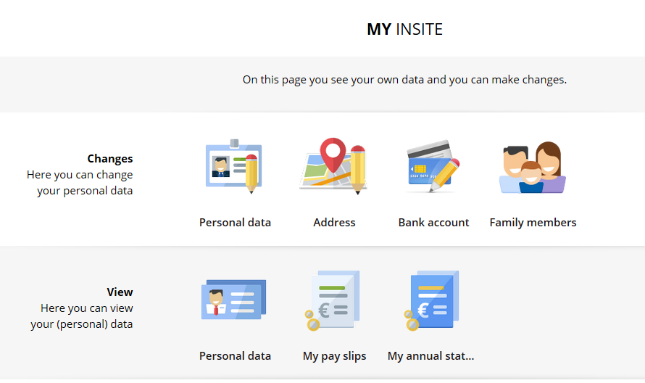
My InSite
  Please see below the options of AFAS InSite.
- Pay slips (View)
- Annual Statement (View)
- Personal Data (View & Change)
- Address (View & Change)
- Bank Account No (View & Change)
- Family Members (incl. Emergency Contact Person (View & Change)

Slide 3
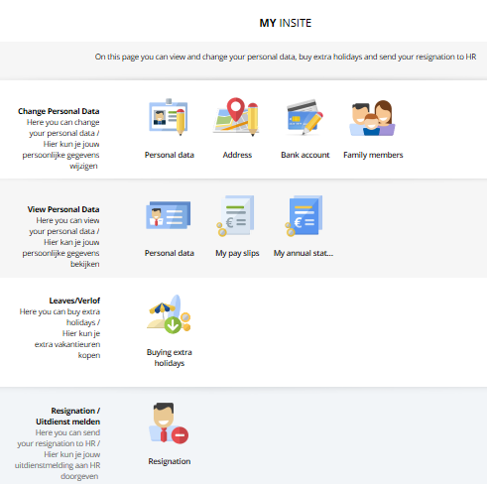
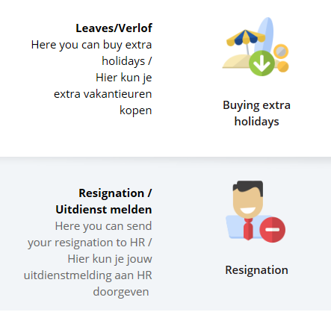
My InSite – continued
  - Buying Extra Holidays
  - Sending your Resignation to HR
  - Receiving and, if applicable, signing HR letters via AFAS InSite

Slide 4
Receiving and Signing
HR Letters

Slide 5
Receiving & Signing HR Letters
  Scope of reviewing HR letters: Receiving → Reviewing → Storing
  Salary Changes
  Personal Allowance
  Replacement Allowance
  Buying Extra Holidays
  Off Boarding – Resignation
  Off Boarding – Legal End of Contract
  Scope of reviewing and signing HR letters: Receiving → Reviewing → Signing → Storing
  Job Changes
  Contract Hours Changes
  Contract Extensions
  Care Leave

Slide 6
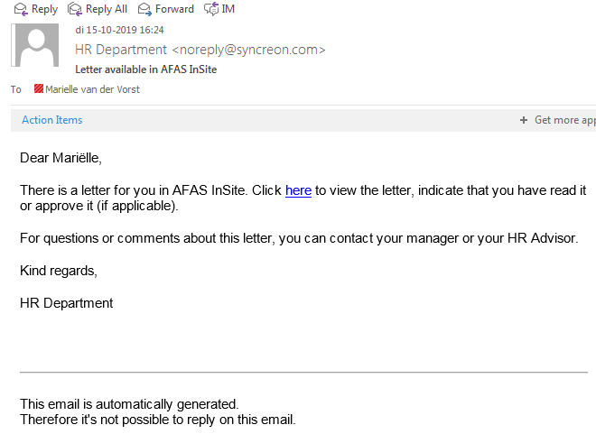
Receiving & Signing HR Letters – continued
  1. HR will send the HR letters mentioned on previous slide via AFAS InSite to the e-mail address that you use to log in AFAS InSite. You will receive the email below, please click ‘here’ to go to AFAS Insite.
Name

Slide 7

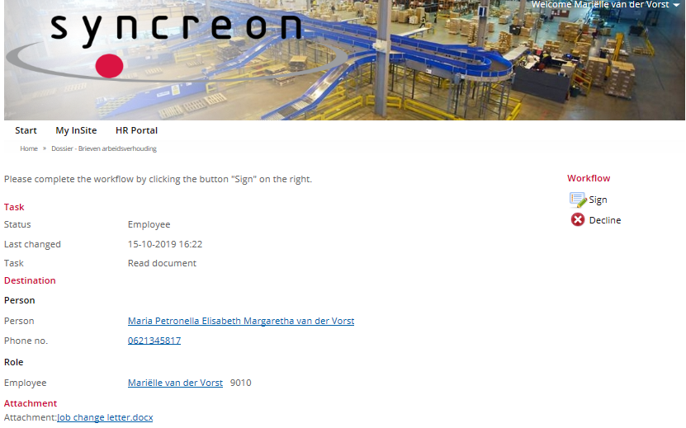
  2. Click the ‘Attachment’
  3. Review the letter
  4A. In case you only need to review the letter, click ‘Read’
  4B. In case you need to sign the letter, click ‘Sign’ or ‘Decline’ (see next pages for signing process)

Slide 8
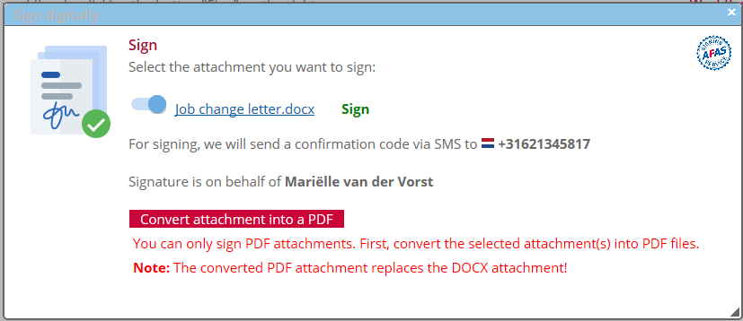
5. Click ‘Convert attachment into a PDF’
Phone number
Name

Slide 9
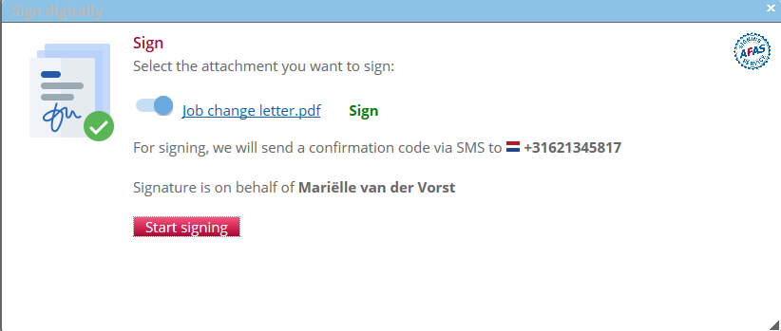
6. Click ‘Start signing’
Phone number
Name

Slide 10
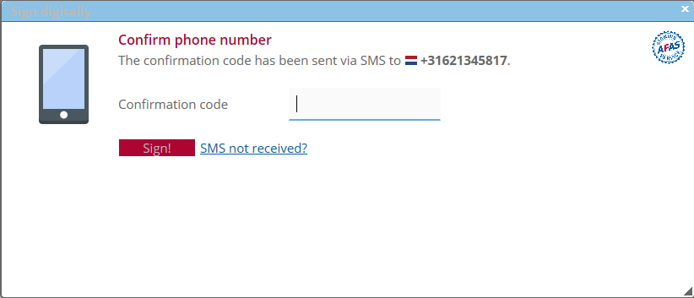
7. Enter the confirmation code that you have received via your phone
Phone number

Slide 11
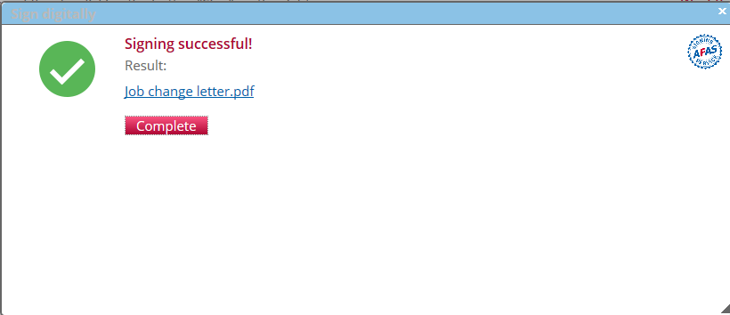
8. Your signing process is completed. Click on the letter to see your digital signature on your letter. You can save the letter on your personal computer for your own administration. Click ‘Complete’.

Slide 12
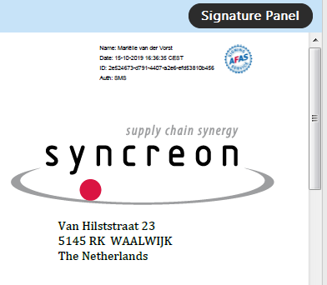
9. You can see on the preview of the letter that your letter is signed (= the AFAS icon). This letter is now
stored in your personnel file in AFAS (our HR/Payroll system).

Slide 13
Questions?
Contact our HR Back Office
hrnl@syncreon.com

